Slide 1
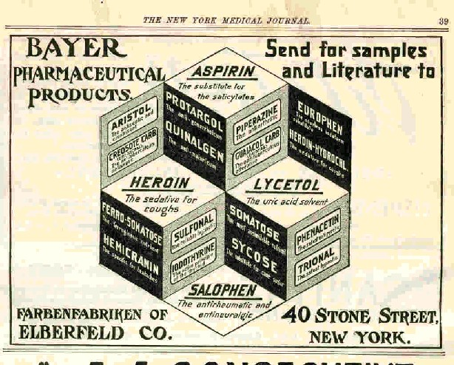
The Long History of Current Affairs

Slide 2
The reading….
Comes from Peter Andreas’ Smuggler Nation: How Illicit Trade Made America.
What do you think Andreas means with that?

Slide 3
“America’s Century-Long Drug War”
“Drug prohibition sharply accelerated and expanded the broader trend of using federal powers to police vice trades. New and more punitive laws were passed, new and more expansive bureaucracies were created to enforce them, new and bigger prisons were built to house violators, and arm-twisting drug diplomacy became a new and increasingly prominent component of U.S. foreign relations. Yet despite this sustained drug war buildup, the illicit drug business not only survived but turned into one of the most profitable sectors of global trade.”
What does such a passage tell us – about drugs? About things outside of drugs?

Slide 4
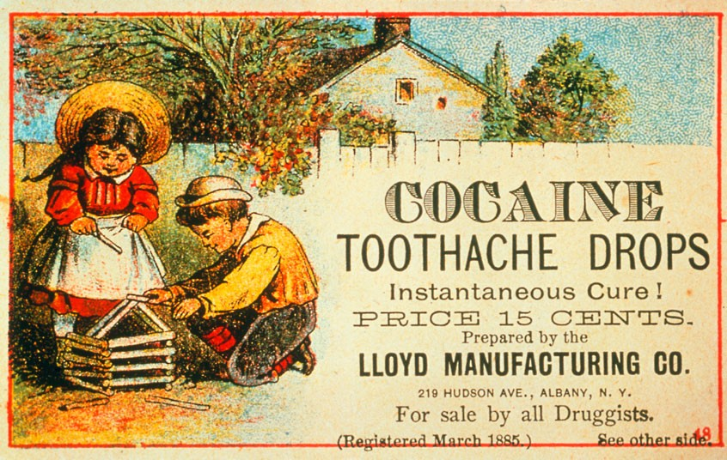
From drugs to DRUGS….
In 1900 opium, morphine, heroin, cocaine, and marijuana were all legal and readily available in the United States.
Used to ease pain and help with sleeplessness.
Could get morphine through Sears!

Slide 5
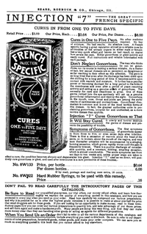
From 1902 Sears catalog….

Slide 6
Yet by the 1930s….
Drug use throughout the United States was publicly condemned. Support grew for strict control of such drugs – and new laws were put on the books to combat such menaces.
What happened?

Slide 7
This is what happened….
“groups in the medical community, reformers in the Progressive movement, moralistic anti-vice crusaders, muckraking journalists, and racist and nativist groups who feared that America would be mongrelized and contaminated by drug-consuming ‘inferior peoples’ were all intent on establishing some kind of regimen for drug control.”
Again, the discourse on drugs was about far more than simply drugs.
What else was it about?

Slide 8
What it was about….
War (impact on Civil War veterans; also Red Scare of WWI).
Professionalization (this is the beginnings of the modern medical industry). This has legal ramifications: The Pure Food and Drug Act of 1906.
Immigration (behavior of those from eastern and southern Europe).
Migration (behavior of those coming from the American South).
Urbanization (and all of these groups coming to live in American cities).
Religion (language of vice and experiences of missionaries in such places as China).

Slide 9
All of these forces….
Come to have an impact on US policy.
In 1909 Secretary of State Elihu Root convinced Congress to ban the importation of all forms of smoking opium.
December 1914: The Harrison Narcotics Act is passed. It grounded federal drug control in the constitutional power to tax, which meant that enforcement powers fell to the Treasury Department.
More about regulation than law enforcement – but this would change quickly.
Why?

Slide 10
Those arguing against ANY use for these drugs….
Evolution within the Treasury Department.
Continued their public campaigns.
Prohibition leaders, successful banning alcohol, turned to drugs.
Created the language of diseased drug user.
WWI
Supreme Court and the law of the land: In Webb v. United States (1919), concluded that it was illegitimate for a doctor to maintain addicts on morphine with no intention of curing them. In United States v. Behrman (1922), the Court established that a narcotics prescription for an addict was illegal unless the addict had some other ailment requiring treatment with narcotics.
“These court rulings transformed the Harrison Act into a prohibition law that conformed to the Treasury Department’s interpretation.”
Echoes of today? By the late 1920s, one-third of inmates in federal prisons were serving sentences for violating the Harrison Act.

Slide 11
The Rise of the Underground Economy
As doctors and pharmacists backed away from prescribing cocaine and opiates, addicts had to get their fix somewhere.
They entered the black market – and New York City emerged as the hub of this market.
Coinciding with a stronger crackdown: in 1924 Congress banned all domestic production and medical use of heroin.
Where did dealers have to turn? Foreign sources.
The beginnings of global drug trade still with us today.

Slide 12
A brief case study: “Killer Weed”
Before the mid-1920s, not so much concern about the use of marijuana.
What brought about change? Association with Mexican migration, particularly during the worst of the Great Depression. Why then?
By 1936, a push to criminalize it.
The Marijuana Tax Act passed in the summer of 1937 – by that time 46 states had place anti-marijuana laws on the books.
In the realm of popular culture, films such as 1936’s Reefer Madness helped cast marijuana as a dangerous drug.

Slide 13
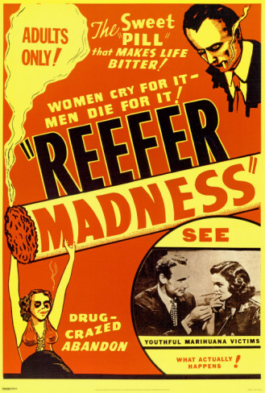
Reefer Madness (1936)

Slide 14
Over time….
More and more money and resources would be poured into this “War on Drugs.”
By late 1960s, it was still public enemy #1.
The federal budget for drug enforcement climbed from $43 million in fiscal 1970 to $321 million in fiscal 1975.
Others soon got in on the “war”: In the fall of 1989 Secretary of Defense Dick Cheney declared drugs to be a high-priority mission of the Department of Defense. Funding for the military’s drug-enforcement activities increased from $357 million in 1989 to more than $1 billion in 1992.
An end-of-Cold War lifesaver for the military? How so?
Had technological impact as well – military equipment and technologies initially designed to deter military invaders were made available to those fighting the War on Drugs.
Who is using these now?

Slide 15
And a continued cultural push….
To define drugs – and drug sellers and users – in certain ways.

Slide 16
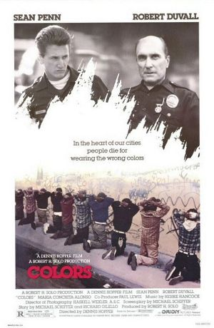
Colors (1988)

Slide 17
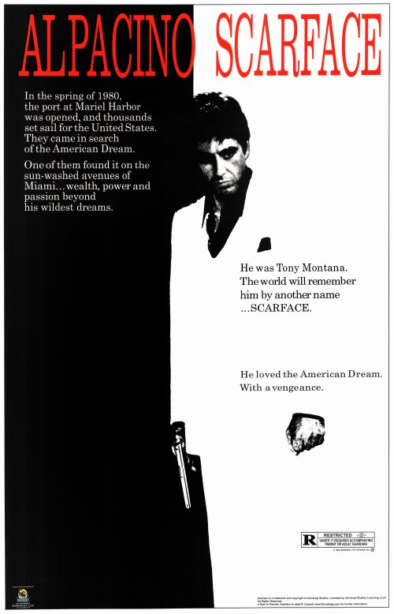
But another version is there as well….

Slide 18
In Scarface (1983)….
the drug dealer as hero.
Even in the face of the growing War on Drugs, demand for such things in the United States continues to grow.
Why?

Slide 19

Even more recently….

Slide 20
And why….
Should we care about all of this in the early 21st Century?

